Slide 1
IGCSE River Revision

Slide 2
You need to know that weathering involves the breakdown of rock in situ and how it is different to erosion
Weathering:
Rocks that are exposed to air, water, changes in temperature and vegetation become vulnerable to weathering. Weathering is the disintegration (breaking up) and decay (decomposition) of rocks where they are formed. It does not involve the movement of material (erosion).
Erosion:
Erosion is the wearing away of this rock and the removal of the weathered material.

Slide 3
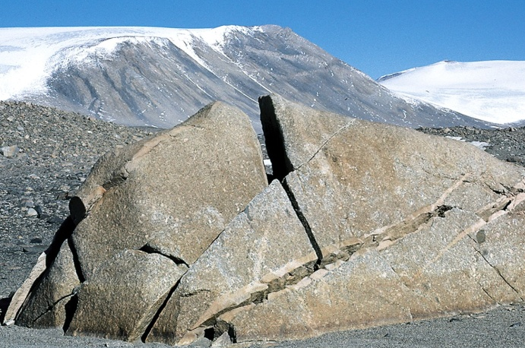
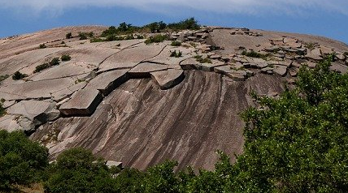
Be able to describe what is meant by different types of weathering – physical/mechanical (freeze-thaw action, exfoliation), chemical (and biological.
Explain the main factors influencing the type and rate of weathering – climate and rock features
There are three main types of weathering:
  Physical – Break up of exposed rock through physical processes
    Freeze thaw/Frost shattering – Occurs mainly in cold climates, where temperatures fall below zero degrees and the rocks have many cracks. E.g. Alaska.
    Onion skin/Exfoliation – Occurs mainly in warm climates where exposed rocks are repeatedly heated and cooled. During the day the surface layers of the rock are heated and expand. During the night the layers contract and this continued process causes the surface to peel like an onion. E.g. Ayers rock, Australia.

Slide 4
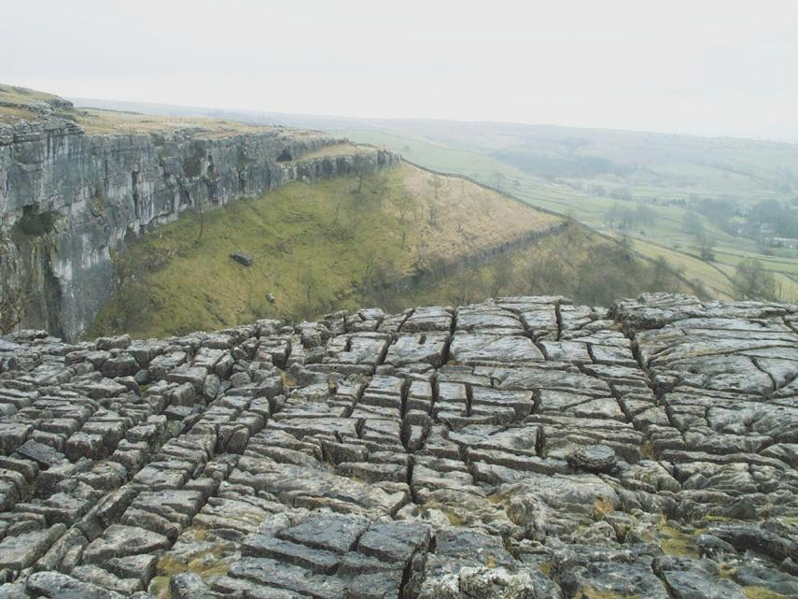
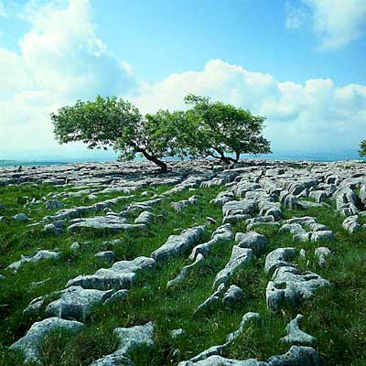
There are three main types of weathering:
  Chemical – Break up of exposed rock through physical processes
    Water and air activate chemical changes that initiate rot and decay. This process is most common where the climate is warm and wet.
    An example of this process is limestone solution. This is when carbonic acid present in rainwater reacts with rocks such as limestone that contains calcium carbonate. As the limestone dissolves it is removed by running water.

Slide 5
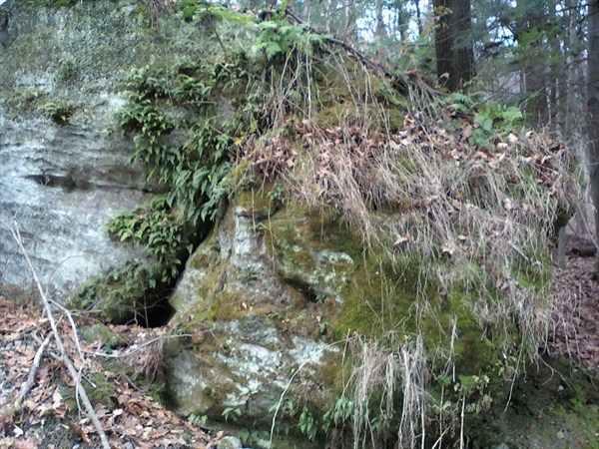
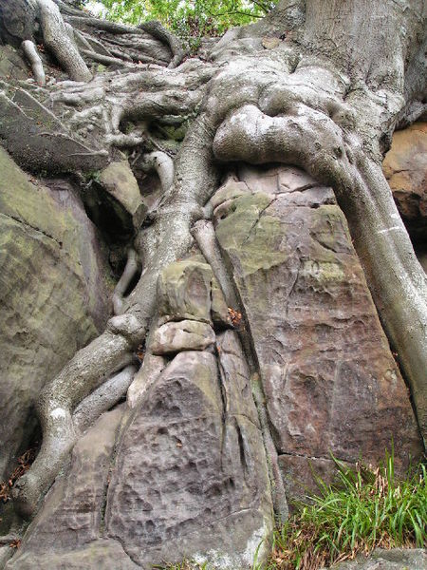
There are three main types of weathering:
  Biological – Requires plant roots or decay
    Occurs when either tree roots penetrate and widen cracks in a rock (physical) or acids, released by decaying vegetation (chemical).

Slide 6
Understand and be able to explain and describe erosional processes of wave and river action: hydraulic action, corrasion (abrasion), corrosion (solution) and attrition
Erosion:
Erosion is the wearing away of this rock and the removal of the weathered material.
Four main agents of erosion (ie things that erode) are:
  Rivers
  Sea
  Ice (glaicers)
  Wind
There are four processes of erosion that happen in both the rivers and seas. These are:
  Hydraulic Action
  Abrasion/Corrasion
  Attrition
  Solution/Corrosion

Slide 7
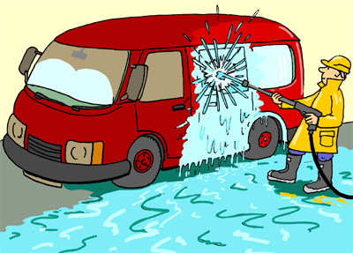
Hydraulic Action
The power of the water.
The hammering effect of fast flowing water (turbulent water) on river beds and banks. The force of the water will loosen particles and then pull them out into the flow of the river.
It is a bit like having a very large hose pipe pointed in the same place for along time.

Slide 8
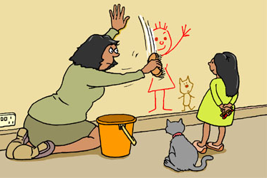
Abrasion/Corrasion
The load of the river or sea (rocks carried along by the river/sea) wear down and scrape the river and sea bed the banks or shore.
This is sometimes called Corrasion

Slide 9

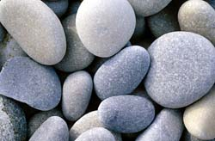
Attrition
The rocks (the load) being carried by the river or sea smash together and break into smaller, smoother and rounder particles.
The key evidence of attrition is that pebbles and rocks are smooth and rounded, perfect for skimming

Slide 10
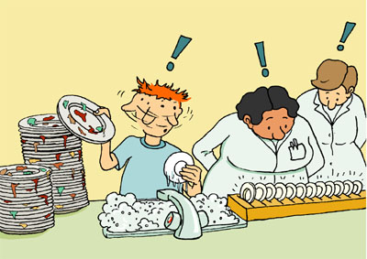
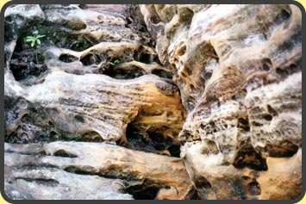
Solution/Corrosion
Solution (sometimes called corrosion) is a chemical process by which weak acids contained in water dissolve the minerals that make up the rocks and soil causing them to disintegrate .

Slide 11
Understand and explain river transport processes including traction, saltation, suspension and solution.
Traction – where large rocks and boulders are rolled along the river bed.
Saltation – where smaller stones are bounced along the river bed in a leap frogging motion
Suspension – where very small grains of sand or silt are carried along with the water
Solution – where some material is dissolved (like sugar in a cup of tea) and is carried downstream.
Traction Saltation Suspension Solution
Shows the rate of flow needed

Slide 12
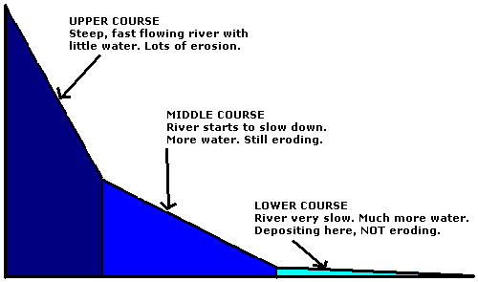
Understand that the effectiveness of the river processes will vary according to the volume and velocity of the running water and the nature of the load (boulders, pebbles, sand and silt) which, in turn, will be affected by the bedrock along the course of the river.
Three River Processes
Erosion
Transportation
Deposition
When the river reaches flat land the river slows down, loses energy so deposits its load. The deposited material is called sediment.
This process builds landforms.

Slide 13
You need to be able to describe and explain the landforms associated with these processes.
Upper Course
River high above sea level (the base level). Lots of potential energy but low volume of water therefore little transportation.
River erodes downwards (vertical erosion) trying to reach base level, so erosion takes place.
Landforms: V-Shaped Valleys, interlocking spurs, Waterfalls, Gorges, Rapids
Middle Course
Lots of energy used to transport eroded material downstream. River closer to base level so more lateral erosion and less vertical erosion
Landforms: Meanders (river bends)
Lower Course
Flat and so less energy to erode.
The Main process here is deposition.
Landforms: Floodplains, meanders, oxbow lakes, levees, deltas and estuaries

Slide 14
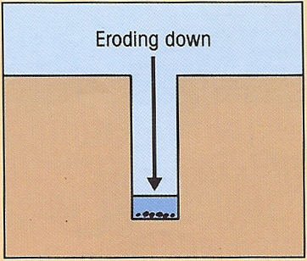
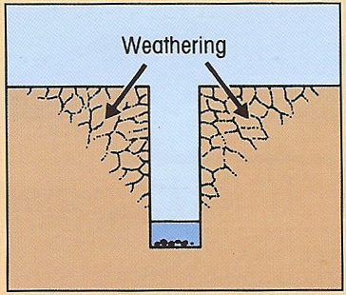
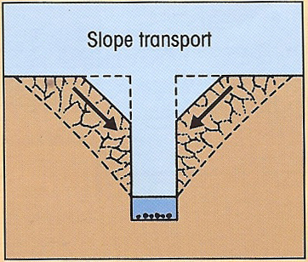
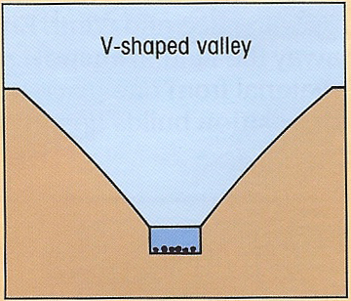
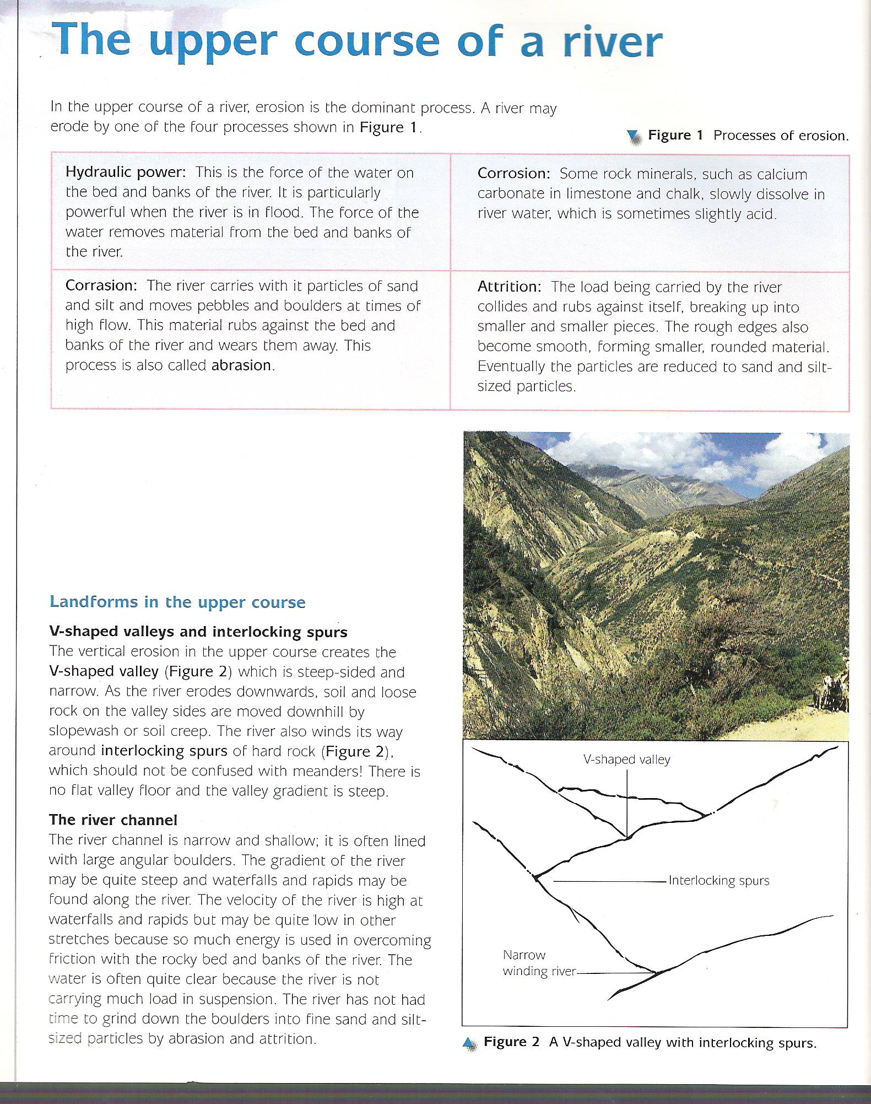
Land forms in the Upper Course
V-Shaped Valleys and Interlocking Spurs
The vertical erosion in the upper course creates a V-Shaped Valley which is steep-sided and narrow. As the river erodes downwards soil and loose rock on the valley sides are moved downhill slopewash or soil creep, creating the v-shaped valley
The river also winds its way around interlocking spurs of hard rock. These should not be confused with meanders.

Slide 15
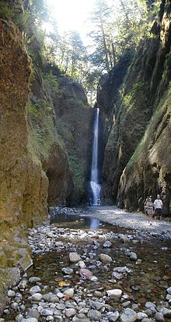
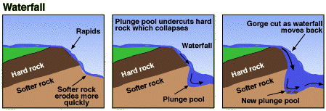
Land forms in the Upper Course
Formation of Rapids, Waterfalls and Gorges
Waterfalls are formed when rivers flow over different types of rock.
The soft rock wears away faster than the hard rock.
In time a step develops over which the river plunges as a waterfall.
Abrasion & hydraulic action erode the pluge pool causing undercutting and making the plunge pool larger

Slide 16
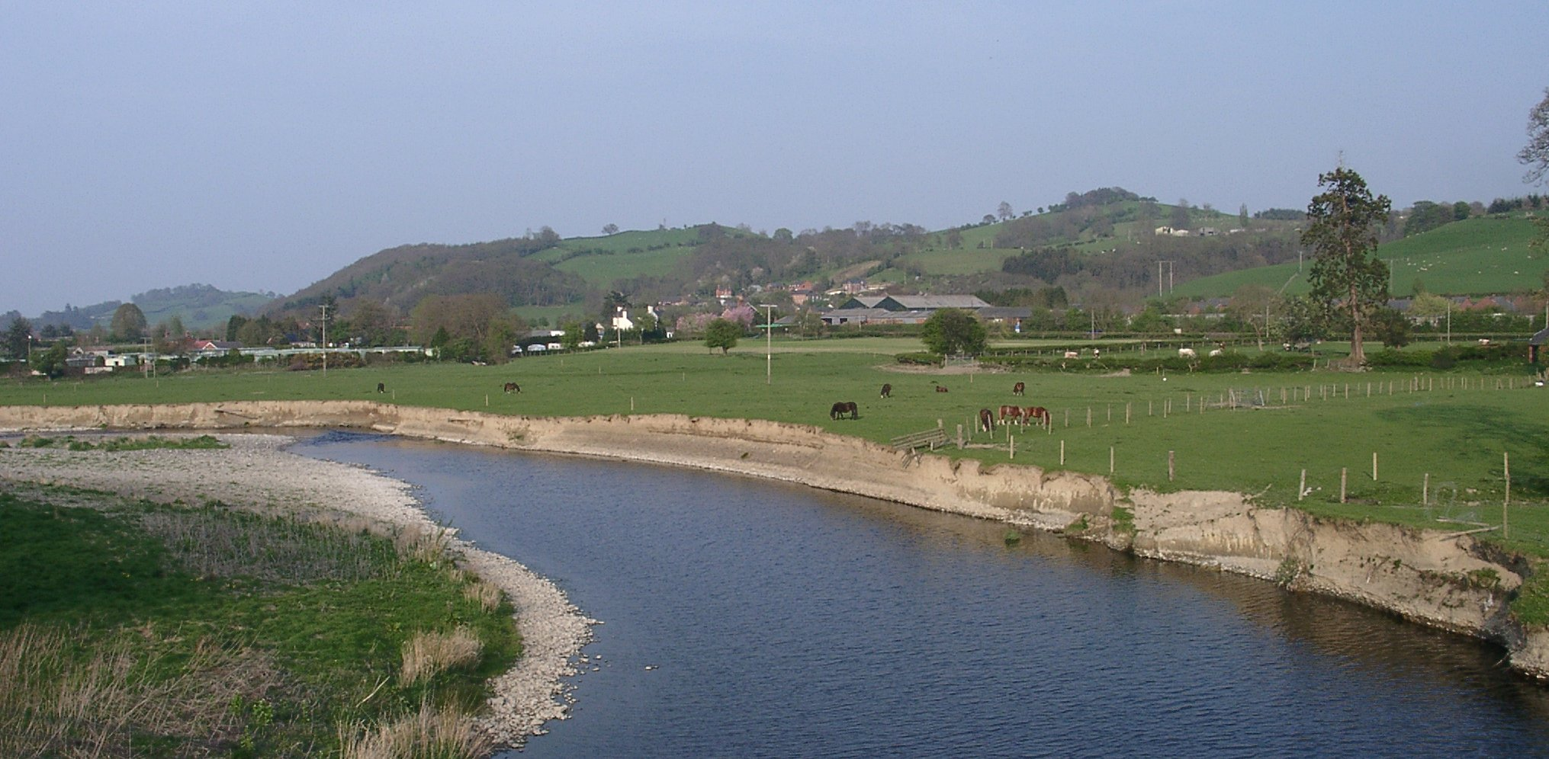
Land forms in the Middle Course
Meanders
When the river emerges from its upland area it begins to meander.
On the outside of a meander the water is deeper and the current flows faster. The force of the water erodes and undercuts the outside bend by abrasion (corrasion) forming a steep bank called a river cliff.
On the inside of the bend the current is less strong, which encourages deposition. This leads t sand and small pebbles being deposited creating a gentle slip-off slope (or river beach. An under water current spirals down the river, carrying the eroded material from river cliff down stream to for a slip-off slope.
Slip-slope or river beach on inside of bend
River cliff on the outside of the bend

Slide 17
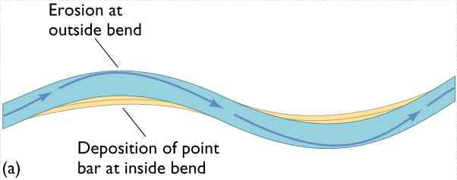
Formation of Meanders

Slide 18
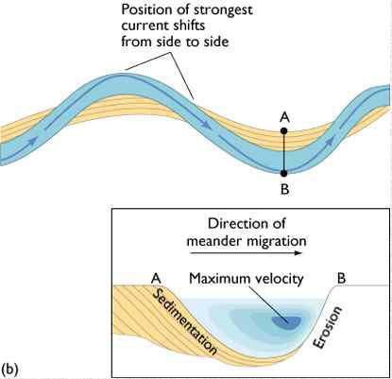
Slip slope or river beach deposits

Slide 19
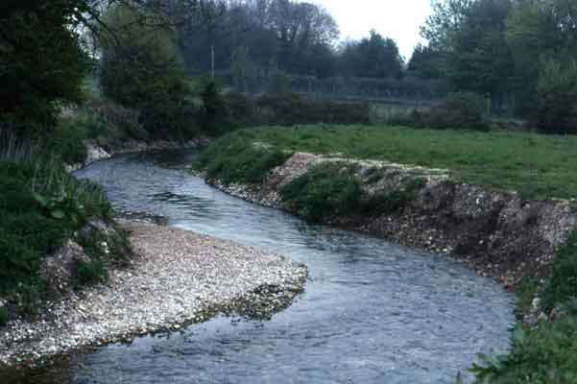
Meander, R. Lavant, Chichester

Slide 20
Meander, R. Lavant, Chichester
WHAT DO THE ARROWS POINT TO?
WHICH WAY IS THIS MEANDER MOVING?
Floodplain
Slip-Off Slope
River Cliff
Point bar deposits on the inner meander bend where there is low energy

Slide 21
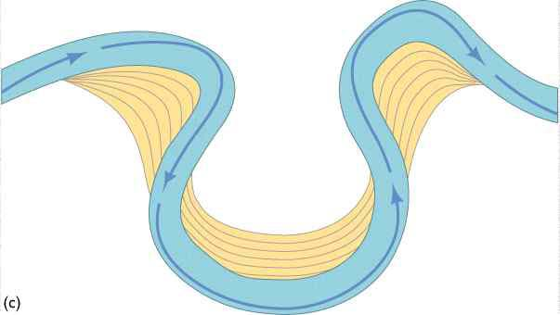
WHERE IS EROSION TAKING PLACE?
Cut bank erosion (River Cliff)
F
A
E
B
Point bar deposits
}
Meander loop
C
D
WHERE IS DEPOSTION TAKING PLACE?

