Slide 1
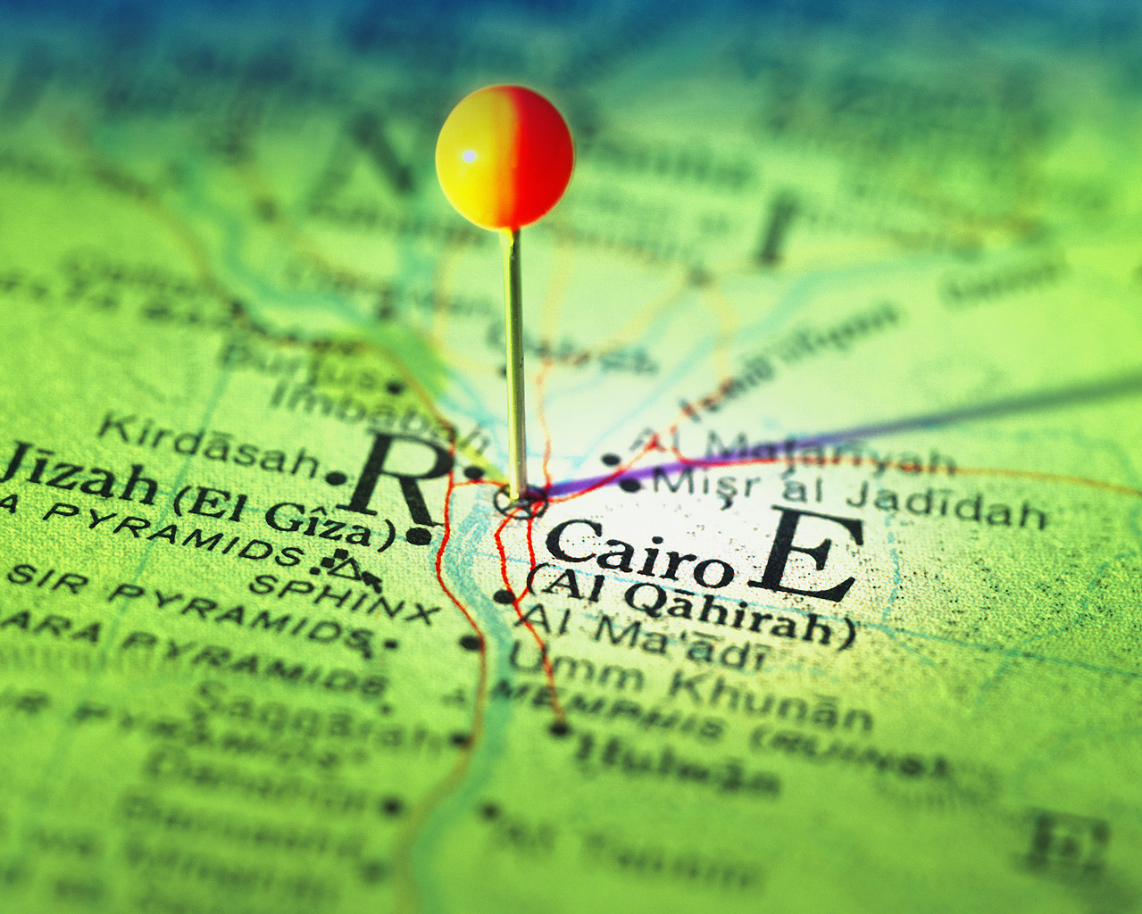
MAP SKILLS

Slide 2
Map skills
You may be expected to use maps in your final exam. Candidates often shy away from questions that use maps because of a lack of confidence in basic map skills.
Confidence in using these resources will save time in the exam and help to gain higher marks.

Slide 3
All Geographers Need to be up to speed on their map skills
Click onto the next slide and choose which skill you wish to practise first.
Each skill has an information section followed by a short test.
At the end of each test you can return to this presentation to select another skill
Good Luck

Slide 4
Geography Revision
Scale and Distance
4 figure grid references
Map Skills Workshop
Click on the skill you wish to practise
Use of maps with photos
Contours
6 figure grid references
Map symbols

Slide 5
Scale and Distance

Slide 6
Map Scales
Large scale maps show the most detail but only cover a small area e.g. road maps, town plans.
Small scale maps show less detail but cover a larger area e.g. maps of the whole of the UK.

Slide 7
How is scale shown on a map?
1. As a written statement
2.As a ratio or fraction
3.Using a scale line.
4cm = 1 Km
1 : 25 000
0 500m

Slide 8
OS Maps
On an OS map the blue grid lines (the eastings and northings) always make up 1Km grid squares.
So these squares will be 4cm long on a 1 : 25000 map but only 2cm long on a 1 : 50 000 map etc.
The scales mean the ratio of the distance on the map with the actual distance in real life.
A 1cm line on a 1 : 50 000 map will be 50 000 cms along the ground (or ½ Kilometre)
Or a 4cm line on a 1 : 25 000 map will be 100 000cms (4 x 25,000) along the ground (or 1 Kilometre)

Slide 9
How to measure distances on a map
1. Straight line distances
The shortest distance between two points is sometimes known as the distance ‘as the crow flies’.
This can be measure with a ruler then converted to the correct scale with reference to the scale bar given on the map.

Slide 10
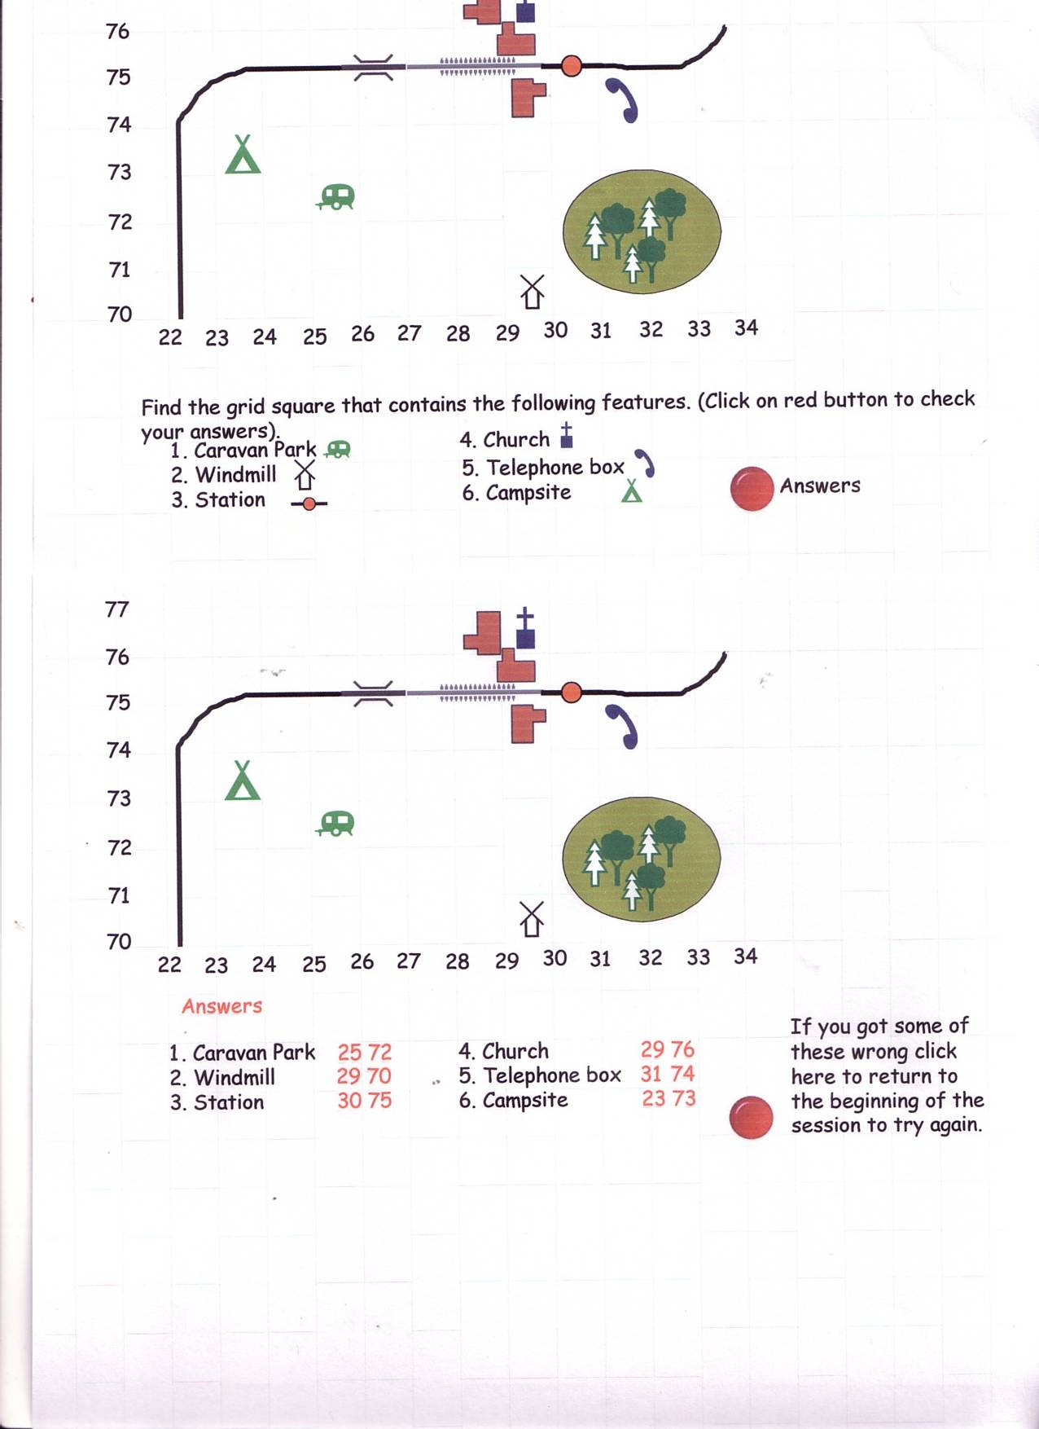
Let’s measure the distance between the caravan park and the windmill on this map.
0 500 1Km 2Km
As you can see the distance is 2Km.

Slide 11
How to measure distances on a map
2. Curved Distances
You may need to measure the distance along a road or river that does not travel in a straight line.
To do this you ideally need a piece of string (or you can use a strip of paper).
You lay the string down to follow the shape then measure the total length before converting back using the scale.
If using paper you need to pivot the paper each time the path changes direction.

Slide 12
Now Let’s measure the distance along the railway on this map.
Note the points where the direction changes.
Measure the distance between each one.
Add them up then convert using the scale bar.
0 500 1Km 2Km
This would be 7½ Km

Slide 13
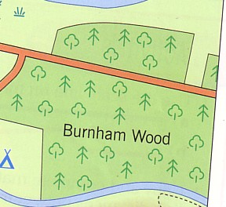
Measurement of distances can be used to work out rough areas of features such as woodlands.
Just measure the two main sides, convert the distances using the scale bar then multiply together to give the rough area.
0 500m
Burnham Wood is roughly 1500m x 1300m which means it has an area of about 1 950 000m square or 1.95Km square.

Slide 14
Some people find the question of measuring distances and calculating scales very confusing.
Click below to either re-read these notes or go onto a short test.
Return to beginning
Return to main menu

Slide 15
4 Figure Grid References
Click here to find out more

Slide 16
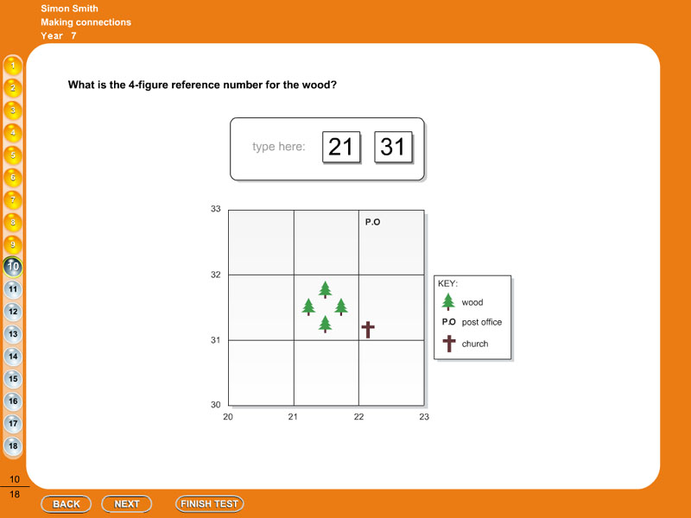
A four figure grid reference points you towards a particular square on a map. On all OS maps these squares represent one square kilometre.
All maps will have lines numbered around the edge. These will not always start at zero but will increase both upwards and across the map. (See the example below). A four figure grid reference will point you to the bottom left hand corner of that particular grid square. Follow the red NEXT buttons to see how these work then try the examples given.

Slide 17
Let’s find grid square 21 31
To read a 4 figure grid reference go along to the line number of the first 2 numbers and then go up to the line with the second 2 numbers.

Slide 18
You are now at the bottom left hand corner of grid square 21 31

Slide 19
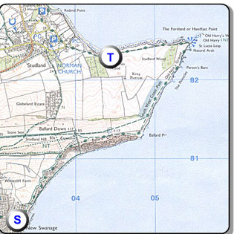
What grid square is the letter T in?
See how the grid line numbers are now shown on the map
Click here to see if you’re right

Slide 20
T is in grid square 04 82
Along to line 04
Up to line 82
Now we are at the bottom left of square 04 82

Slide 21
Now try your hand at these…..
1. What square is the Caravan Park on the map on the following page?
Click here for map

Slide 22
Decide what you think the grid square is then click on the red button to check your answer

Slide 23
Caravan Park is in grid square 25 72.

Slide 24
2. What square is the Windmill on the map on the following page?
Click here for map

Slide 25
Which grid square is the windmill in?
Click on the red button to check your answer

Slide 26
The Windmill is in grid square 29 70.

Slide 27
3. What square is the station on the map on the following page?
Click here for map

Slide 28
Which grid square contains the station?
Click on the red button to check your answer

Slide 29
The station is in grid square 30 75.

Slide 30
4. What square is the church in on the map on the following page?
Click here for map

Slide 31
Decide what you think the grid square is then click on the red button to check your answer

Slide 32
The church is in grid square 29 76.

Slide 33
5. What square is the telephone box in on the map on the following page?
Click here for map

Slide 34
The telephone is in which grid square?
Click on the red button to check your answer

Slide 35
The telephone box is in grid square 31 74.

Slide 36
6. What square is the campsite in on the map on the following page?
Click here for map

Slide 37
Decide what you think the grid square is then click on the red button to check your answer

Slide 38
The campsite is in grid square 23 73.

Slide 39
Did you get all those right?
Yes click here to return to main menu and choose another skill

Slide 40
6 Figure Grid References

Slide 41
It is useful to understand how to use 4 figure grid references before continuing on to look at 6 figure grid references.
If wish to look at the 4 figure grid reference section please click here.
Otherwise click here to continue.

Slide 42
A four figure reference will point you to a square on the map.
Six figure grid references are used to pin point a location within a square.
It is important to be able to both find details given by a 6 figure grid reference as well as being able to work out the 6 figure grid reference for any point on the map.

Slide 43
How to work out 6 figure grid references…
Let us first look at how the 6 figure grid reference is made up.
Let us take 216 322 as an example.
The first 3 figures refer to the easting of the point (or the distance along the map)
While the second 3 figures refer to the northing of the point (or the distance up the map).

Slide 44
Looking at our number 216 322
Start by working out the basic Easting and Northing as you would for a 4 figure
grid reference using only the first 2 easting values and the first 2 northing values.
Then imagine that grid square divided into tenths.
216 is the Easting.
21 is the grid line and 6 is the number of tenths along towards the next grid line.
322 is the Northing.
32 is the grid line and 2 is the number of tenths along towards the next grid line.

Slide 45
Let us find the 6 figure grid reference for the church on the map below
The church is in grid square 22 31.
If we imagine that square divided into 10 parts, the church is 2 tenths further east and 2 tenths further north.
So the 6 figure grid reference will be 222 312

Slide 46
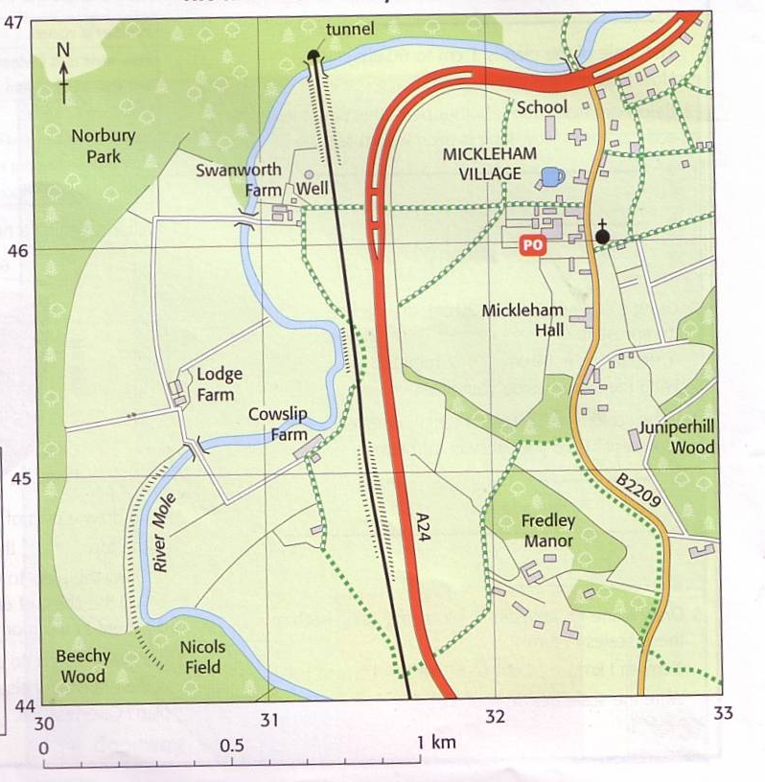
Now try a few on your own…
What is the 6 figure grid reference for the church?
A 461 325
B 325 460
C 328 460
Click on the answer of your choice.

Slide 47
Sorry you are wrong go back and try again

Slide 48
Well done that is correct
Click here for next question

Slide 49
Now try a few on your own…
What is the 6 figure grid reference for Lodge Farm?
A 303 458
B 453 305
C 306 454
Click on the answer of your choice.

Slide 50
Sorry you are wrong go back and try again

Slide 51
Well done that is correct
Click here for next question

Slide 52
Now try a few on your own…
What is the 6 figure grid reference for the school?
A 323 465
B 332 456
C 313 465
Click on the answer of your choice.

Slide 53
Sorry you are wrong go back and try again

Slide 54
Well done that is correct
Click here for next question

Slide 55
Now try a few on your own…
What is the 6 figure grid reference for the well?
A 463 315
B 316 467
C 313 463
Click on the answer of your choice.

Slide 56
Sorry you are wrong go back and try again

Slide 57
Well done that is correct
Click here for next question

Slide 58
Now try a few on your own…
What is at 6 figure grid reference 325 456?
A The Post Office
B Mickelham Hall
C Cowslip Farm
Click on the answer of your choice.

Slide 59
Sorry you are wrong go back and try again

Slide 60
Well done that is correct.
If you now feel more confident about 6 figure grid references click here to return to the main menu.
If you want to return to the beginning of this section on 6 figure grid references click here.

