Slide 1
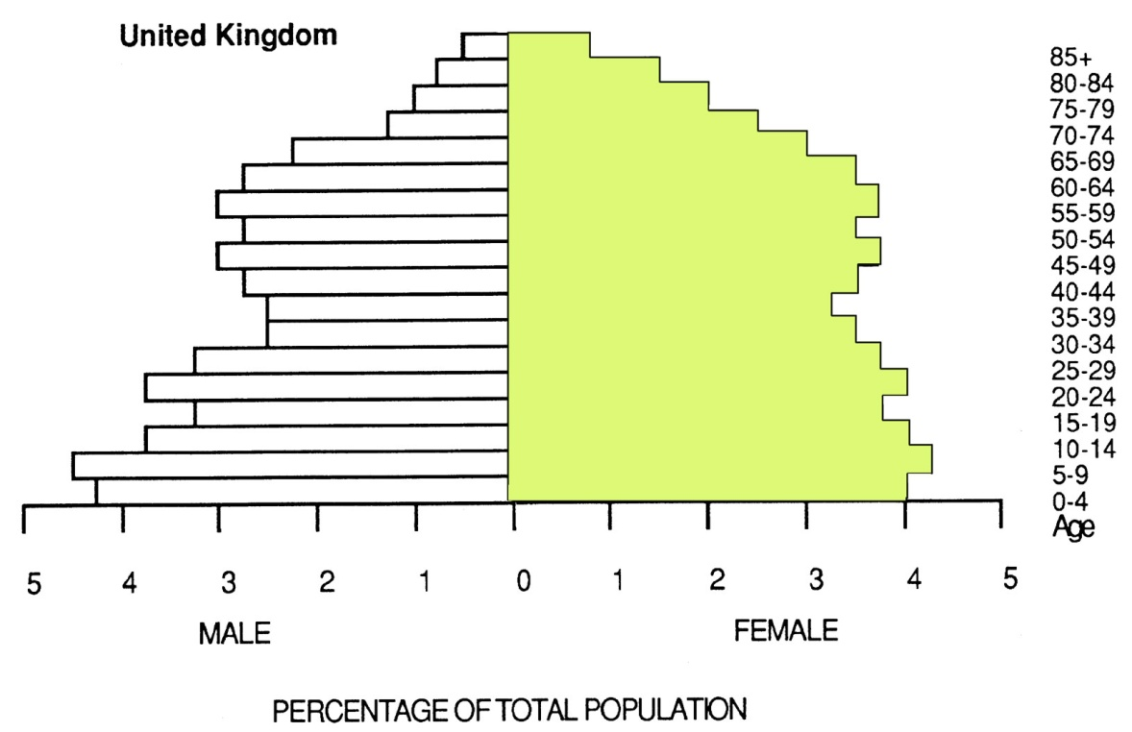
POPULATION STRUCTURE
The population pyramid displays the age
and sex structure of a country or given area
OLD DEPENDANTS
ECONOMICALLY
ACTIVE
YOUNG
DEPENDANTS
Population in
Five Year
Age bands
FEMALES
To the right
MALES
To the left
Usually, but not always,
In % to make for easier
comparisons
between countries

Slide 2
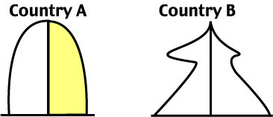
What Population Pyramids Show Us
Economically
More
Developed
Country
Economically
Less
Developed
Country
KEY
slope of pyramid indicate the death rate
width of the base is related to birth rate/fertility rate
proportions of men and women can suggest male or female migrations
height of graph can indicate life expectancy (ignore the very thin end of the wedge as occurs on graph B as these people are a definite minority)
"kinks" indicate dramatic reductions in birth rate or increases in death rate in the past
area of graph indicates total population - compare areas of different population age groups or different sex on one graph
The overall shape of the population pyramid can indicate whether it is an
Economically More Developed Country or Economically Less Developed Country

Slide 3
Population Pyramids related to the
Demographic Transition Model
Stage 1
Stage 2
Stage 3
Stage 4
IMPLICATIONS
IMPLICATIONS
IMPLICATIONS
IMPLICATIONS
Both birth rates and
Death rates are
High, so population
growth rates are
slow but population
Is usually restored
Due to high birth
Rate. Short life
Expectancy
EXAMPLES
Population starts
to grow at an
exponential rate due to fall in Crude Death Rate. More living In middle age.
Life expectancy rises
Infant mortality rate falls.
EXAMPLES
Population continues
to grow but at slower
rate. Low C Death Rate.
Dramatically declining
Crude Birth Rate.
EXAMPLES
Low Crude Birth Rate
and Crude Death Rate
Higher dependancy ratio
and longer life expectancy
Crude Death Rate does
Rise slightly because of
The ageing population
EXAMPLES
Scotland today.
Japan, USA
Scotland before 1760
New Guinea
Remote parts of
Amazonia
Scotland 1760 - 1830
Republic of Congo
Scotland 1870 -1950
Algeria, Tunisia
Morocco
There is some merit in including or considering
a Stage 5 today with a declining population

