Slide 1
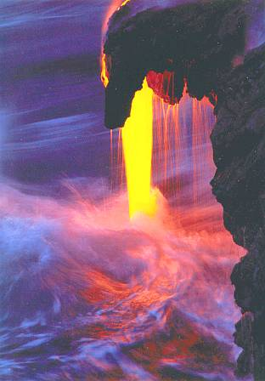
Structure of a Volcano

Slide 2
Objectives
1. To learn the structure of a volcano
2. To know that volcanoes can be dormant, active and extinct
key words
Earthquake, volcano, plate margin, plates.

Slide 3
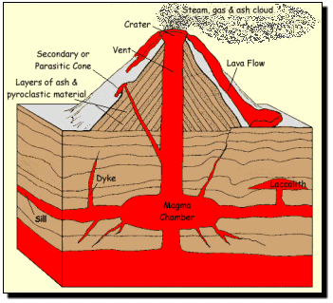
Structure of a Volcano.

Slide 4
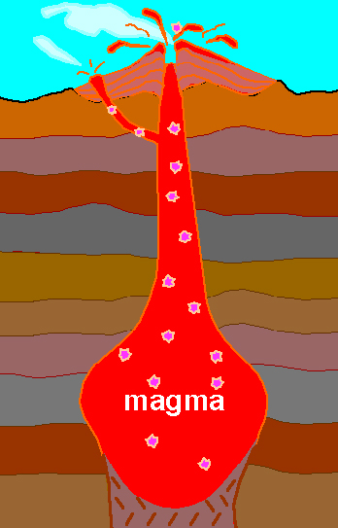
Structure of a Volcano.
Secondary cone
Volcanic
Bombs
Secondary
vent
Crater
Main
Vent
Magma
chamber

Slide 5
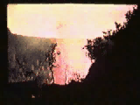
Volcanic Eruptions

Slide 6
Volcanoes can be either Active, Dormant or Extinct.
Active Volcanoes
A volcano which has erupted recently
Dormant Volcanoes
A volcano which has erupted in the last 2000 years,
but not recently is dormant or asleep.
Extinct Volcanoes
A volcano which is unlikely to erupt ever again and is
dead or extinct.

Slide 7
Task
Complete worksheet 1 on Structure of a Volcano.
Copy summary page 37.
Draw the 3 types of volcanoes from page 37
Complete activities 1, 2 and 3 page 37
Write in sentences and use pen only.
Homework.
Create a wordsearch on the structure of a volcano. Include 8 words.

