Slide 1
LEARNING OBJECTIVES
UNDERSTAND THE STRUCTURE OF THE EARTH
IDENTIFY THE DIFFERENT LAYERS OF THE EARTH

Slide 2
TECTONICS?

Slide 3
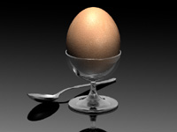
THE EARTHS STRUCTURE -STARTER
CAN YOU THINK WHAT THIS IMAGE HAS TO DO WITH THE EARTHS STRUCTURE?
YOU HAVE ONE MINUTE TO SEE IF YOU CAN COME UP WITH AN ANSWER

Slide 4
THE EARTHS STRUCTURE
ALTHOUGH IT MAY SOUND STRANGE A GOOD WAY AT UNDERSTANDING THE STRUCTURE OF THE EARTH IS TO THINK OF IT AS AN EGG.
THE THIN SHELL IS THE ‘CRUST’
THE WHITE SOFT PART IS THE ‘MANTLE’.
THE YELLOW YOLK IS KNOWN AS THE ‘CORE’

Slide 5
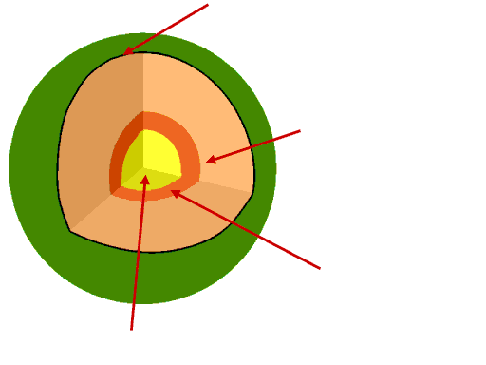
THE EARTHS STRUCTURE
CAN YOU IDENTIFY THE CORRECT LAYERS
USE YOUR WORKSHEET PROVIDED TO CORRECTLY LABEL THE DIFFERENT LAYERS
Crust
Mantle
Outer Core
Inner Core

Slide 6
THE EARTHS STRUCTURE
WHAT DO YOU THINK THE CORE IS MADE OF?
The core is mainly made of iron
WHAT TEMPERATURE DO YOU THINK THE MANTLE IS?
The mantle is approximatley 1000C, relatively cool compared to that of the core
WHAT DO YOU THINK HAPPENS WITH PRESSURE THE FURTHER YOU GO DOWN THROUGH THE EARTHS STRUCTURE

Slide 7
THE EARTHS STRUCTURE
WHAT DO YOU THINK THE MANTLE IS MADE OF? HOW DO YOU THINK PLATES MANAGE TO ‘FLOAT’ ON THE MANTLE?
The mantle is made of a number of materials such as iron, magnesium, aluminium and oxygen.
WHAT SORT OF TEMPERATURE DO YOU THINK THE CORE IS?
The core is approximatley 4300 C the outer core is less hot at about 3700 C

Slide 8
THE EARTHS STRUCTURE
How thick do you think the crust is?
Roughly between 5-30km thick
How thick do you think the mantle is?
Approximatley 2900km
How thick do you think the core is?
The liquid outer core is roughly 2200km and the solid inner core is 1250km thick
From the information you have just gained go back to your diagram and add the relevant information to it eg temperature/thickness etc.

Slide 9
TYPE
THICKNESS
TEMPERATURE
MATERIAL
CRUST
5 – 30 km
N/A
Rock minerals
MANTLE
2900 km
1000 C
Iron, magnesium and aluminium
INNER CORE
2200 km
4300 C
Solid iron
OUTER CORE
1250 km
3700 C
Molten iron

Slide 10
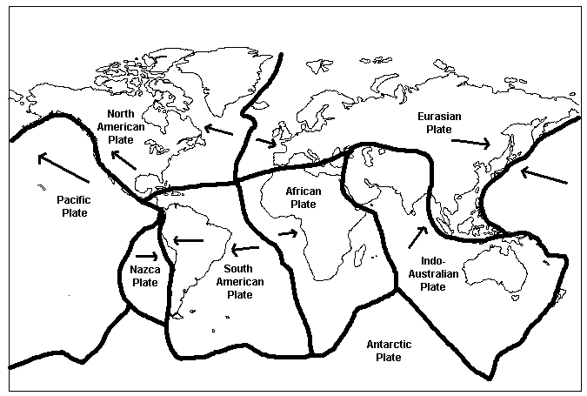
TECTONIC PLATES
WHAT DO YOU NOTICE ABOUT THE NAME OF THE PLATES AND THEIR LOCATIONS?
WHAT DO YOU THINK THE ARROWS REPRESENT?

Slide 11
TRUE OR FALSE?
THE HOTTEST PART OF THE EARTH IS THE MANTLE
TECTONIC PLATES ARE OFTEN NAMED AFTER THE CONTINENT THEY SIT ON
THE INNER CORE IS MADE OF SOLID IRON
PLATES MOVE IN THE SAME DIRECTION
THE MANTLE IS ROUGHLY BETWEEN 5-30km thick

