Slide 1
The Earthquake that shook Northern Italy Case Study: Emilia Romagna 2012
IGCSE Geography (0460)

Slide 2
Causes of the Emilia Romagna Earthquake
20th of May 2012
Epicenter – Mirandola
Focus depth between 6.5km.
Magnitude 5.9 at Epicenter
Padan-Adriatic Thrust Fault activated from North East to South West.
Largest earthquake in the area since the 14th Century.

Slide 3
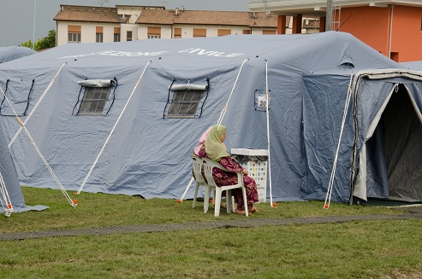
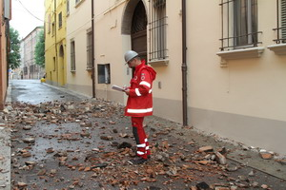
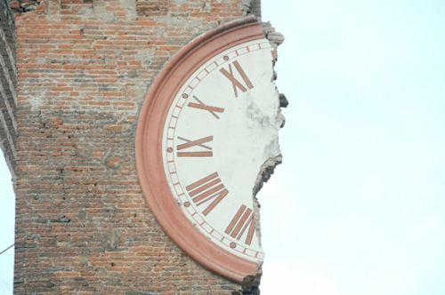
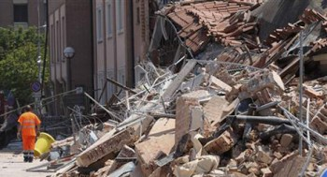
Effects of an Earthquake

Slide 4
Effects
Liquefaction (reduction of soil strength
Ground fractures
Building damage (Many renaissance architecture damaged)
Building collapse
Economic Impact due to damage and collapse leading to reduced output
Homelessness
15 deaths reported
People missing

